Slide 1
W04 – Pyspark – coding standards & best practices
2024
The Hoang

Slide 2
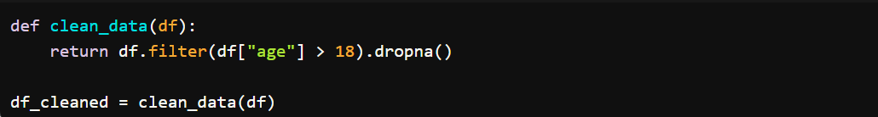
Coding Standards & Best Practices
Modularize Code
Define reusable functions: Avoid duplicating code by abstracting commonly used logic into functions.
Use classes and modules: If your project is large, break the code into classes or modules for better organization and reusability.

Slide 3
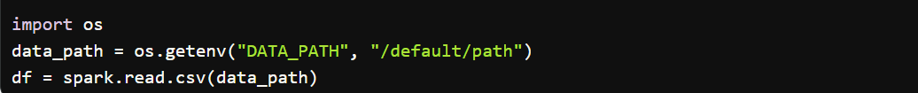
Coding Standards & Best Practices
Avoid Hardcoding
Use configuration files or environment variables for paths, schema definitions, and other parameters.

Slide 4
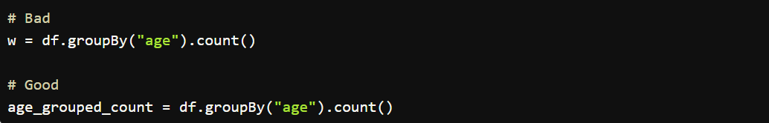
Coding Standards & Best Practices
Use Meaningful Variable Names
Make your variable names descriptive and adhere to PEP 8 naming conventions.

Slide 5
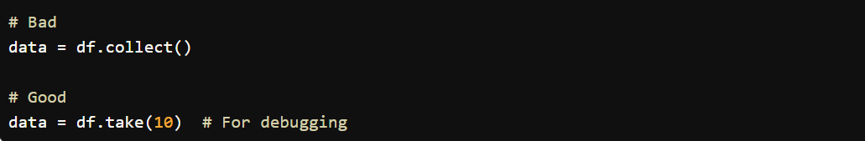
Coding Standards & Best Practices
Avoid collecting data to driver
Avoid excessive use of collect(): collect() brings all data to the driver, which can cause memory issues for large datasets. Instead, use take() or show() for debugging small samples

Slide 6
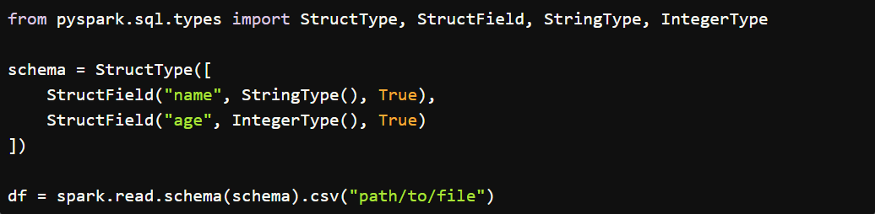
Coding Standards & Best Practices
Use schema definitions
Define schemas explicitly when reading data, especially from CSV or JSON, to avoid expensive inference.

Slide 7
Performance Optimization Best Practices
Partitioning and Parallelism
Tune parallelism: Set the number of partitions based on the size of your data and the cluster setup.

Slide 8
Performance Optimization Best Practices
Repartition vs. Coalesce
Use repartition() to increase partitions (for parallelism) and coalesce() to reduce partitions (for actions like writing to disk).

Slide 9
Performance Optimization Best Practices
Avoid small file problems
When writing data to disk, avoid generating too many small partitions by using coalesce() before writing

Slide 10
Performance Optimization Best Practices
Use Caching and Persistence
Cache reuseable DataFrames: If a DataFrame is used multiple times, cache or persist it in memory. Use unpersist() to free up the memory when not needed

Slide 11
Performance Optimization Best Practices
Choose appropriate persistence levels:
MEMORY_ONLY
MEMORY_AND_DISK
MEMORY_ONLY_SER – “ser” means serialized => taking less memory
MEMORY_AND_DISK_SER
DISK_ONLY
MEMORY_ONLY_2 => “_2” means replicate each partition to 2 cluster nodes
MEMORY_AND_DISK_2

Slide 12
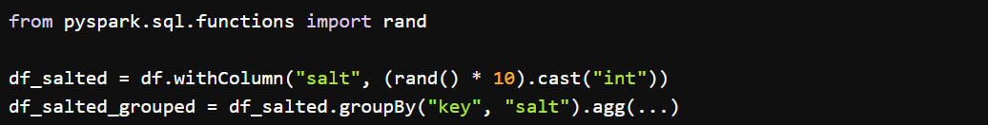
Performance Optimization Best Practices
Avoid Skew and Data Shuffling
Prevent data skew: If certain keys dominate a dataset, it can cause partition imbalance. Use techniques like salting to distribute the load

Slide 13
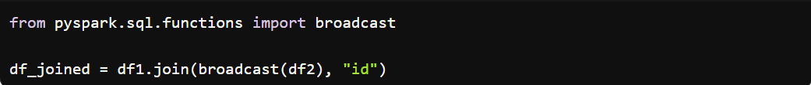
Performance Optimization Best Practices
Minimize shuffles: Avoid wide transformations like groupBy, join, and distinct unless necessary. Use broadcast joins when one dataset is small

Slide 14
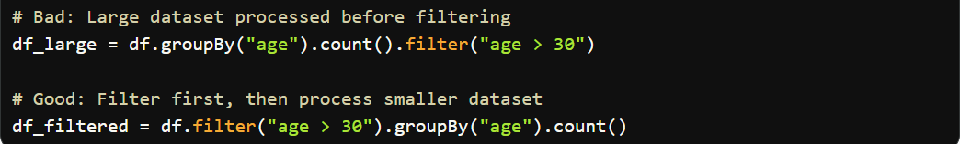
Performance Optimization Best Practices
Filter Early and Reduce Data Size
Filter early: Apply filter() or select() as early as possible to reduce the size of the dataset.

Slide 15
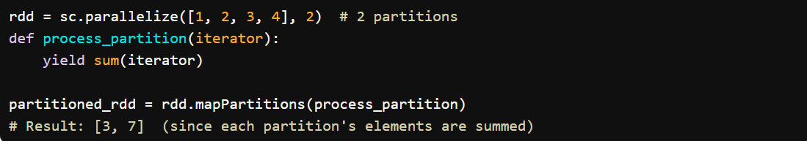
Performance Optimization Best Practices
Use mapPartitions() for Heavy Computations
Instead of applying a function to each element, it applies the function to an iterator over the elements in each partition. This gives more control over partition-level operations and can be more efficient for certain use cases.
It is useful when you want to apply transformations over a partition of elements, rather than element-wise processing

Slide 16
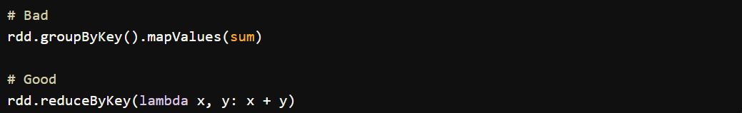
Performance Optimization Best Practices
Use reduceByKey() Instead of groupByKey()
Avoid groupByKey(): It shuffles all data, potentially causing memory issues. Use reduceByKey() for combining values by key without shuffling all data.
reduceByKey() applies the reduce function (e.g., sum, max, min) locally before shuffling the data, reducing the amount of data transferred across the network.
groupByKey() does not perform any aggregation before the shuffle; it transfers all records associated with a key, which can lead to higher network overhead and memory usage.

Slide 17
Debugging and Monitoring Best Practices
Use Logs for Debugging
Enable logging: Use Spark’s built-in logging to track the progress and errors in your application.

Slide 18
Debugging and Monitoring Best Practices
Use explain()
Call df.explain() to see the logical and physical execution plan of your DataFrame transformations.

Slide 19
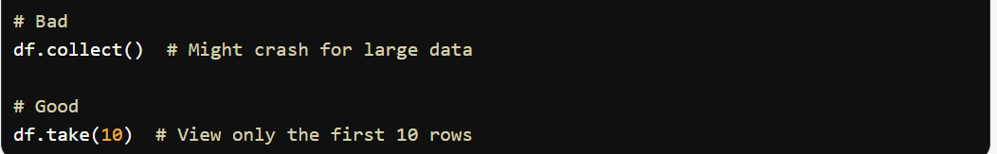
Debugging and Monitoring Best Practices
Use take() Instead of collect()
When debugging, use take() to view a small sample of the dataset instead of collect() to avoid memory overload.

Slide 20
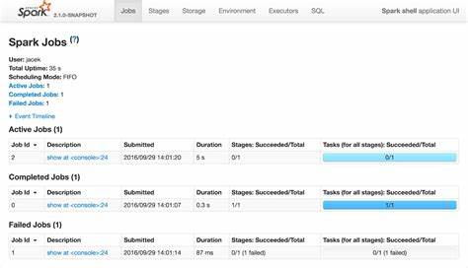
Debugging and Monitoring Best Practices
Monitor Spark UI
Use the Spark Web UI: This provides valuable insights into job execution, including task durations, shuffle behavior, and memory usage. The UI is available at http://<driver-node>:4040 when running locally or on a cluster.
Stages and tasks: Check if too many tasks are running out of memory or taking too long.
Storage tab: Monitor how much data is cached and persisted.

Slide 21
Debugging and Monitoring Best Practices
Use assert() for Data Validations
To ensure data integrity during development, use assertions to validate assumptions about your data.

Slide 22
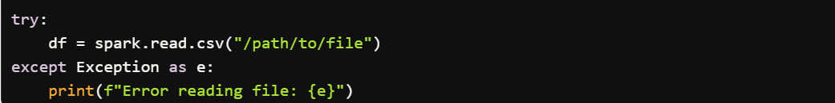
Debugging and Monitoring Best Practices
Handle Exceptions Properly
Use try-except blocks to gracefully handle errors, especially when dealing with external data sources.

Slide 23
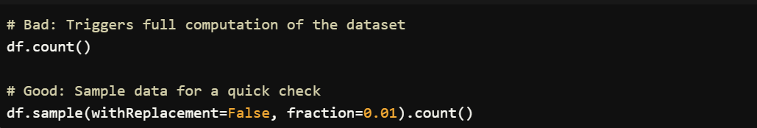
Handling and Managing Data
Avoid count() for Large Datasets
Avoid using count() on large datasets as it triggers a full computation.

Slide 24
Handling and Managing Data
Use broadcast() for Small Datasets
Use broadcasting for small lookup tables to avoid shuffling large datasets during joins

Slide 25
Handling and Managing Data
Use Columnar Formats
Prefer Parquet or ORC over CSV or JSON for storing structured data, as they are more efficient for both storage and query performance..

Slide 26
Miscellaneous Tips
Use the Latest PySpark Version
Keep your PySpark version up-to-date to take advantage of performance improvements and new features.

Slide 27
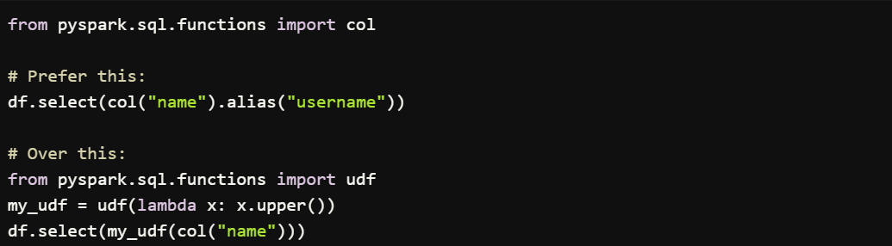
Miscellaneous Tips
Avoid Using UDFs Unless Necessary
Avoid using User Defined Functions (UDFs) unless absolutely required, as they can be slower than built-in Spark SQL functions. Instead, leverage PySpark SQL functions

Slide 28
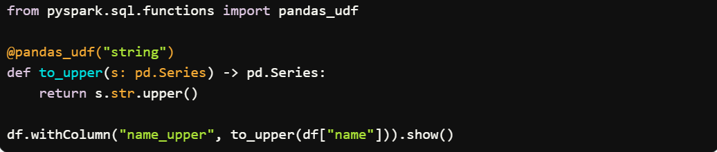
Miscellaneous Tips
Use Vectorized UDFs (Pandas UDFs) Where Necessary
If UDFs are necessary, prefer Pandas UDFs (vectorized UDFs) which are much faster than standard UDFs.

Slide 29
Miscellaneous Tips
Use Vectorized UDFs (Pandas UDFs) Where Necessary
If UDFs are necessary, prefer Pandas UDFs (vectorized UDFs) which are much faster than standard UDFs.

Slide 30
Prefer PySpark Pandas API over Pandas
When working with big data in PySpark, it's often better to prefer PySpark's Pandas API (pyspark.pandas) over the original Pandas API for several reasons related to scalability, performance, and memory management.
Feature | Pandas | PySpark Pandas API (pyspark.pandas)
Memory Management | Entire data in memory | Distributed, lazy evaluation, spilling to disk if needed
Dataset Size Limitations | Limited by system memory | Can handle datasets larger than memory
Execution | Single-threaded | Distributed across a Spark cluster
Performance | Slower for large datasets | Faster for large datasets due to parallelization
Interoperability with PySpark | No direct interoperability | Seamless conversion to/from PySpark DataFrame
Cluster Utilization | Not cluster-aware | Leverages Spark cluster resources

Slide 31
Summary of Best Practices
Category | Best Practices
Coding Standards | Modularize code, use meaningful variable names, avoid hardcoding, avoid excessive collect(), define schemas explicitly.
Performance Optimization | Tune partitioning, use cache()/persist(), avoid data shuffling, filter early, use reduceByKey(), broadcast small datasets, use mapPartitions() properly.
Debugging and Monitoring | Use Spark UI, explain(), take() for debugging, handle exceptions, use assertions for validations, monitor logs.
Data Management | Avoid count(), use broadcast() for small datasets, prefer columnar formats (Parquet, ORC), partition data when writing.
Miscellaneous | Avoid UDFs unless necessary, use Pandas UDFs if required, keep PySpark up-to-date. Prefer PySpark Pandas APIs over the Original Pandas APIs

